Slide 1

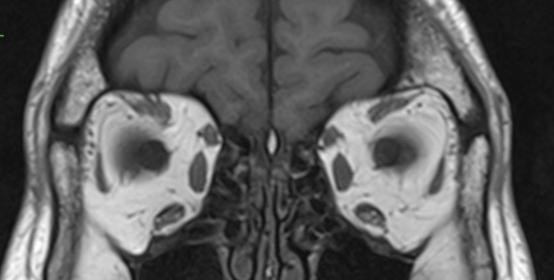
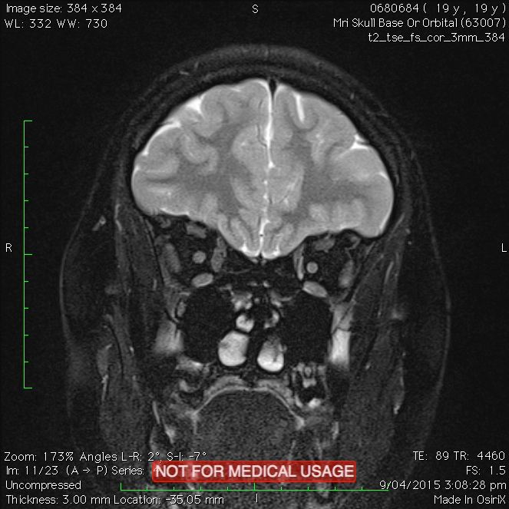
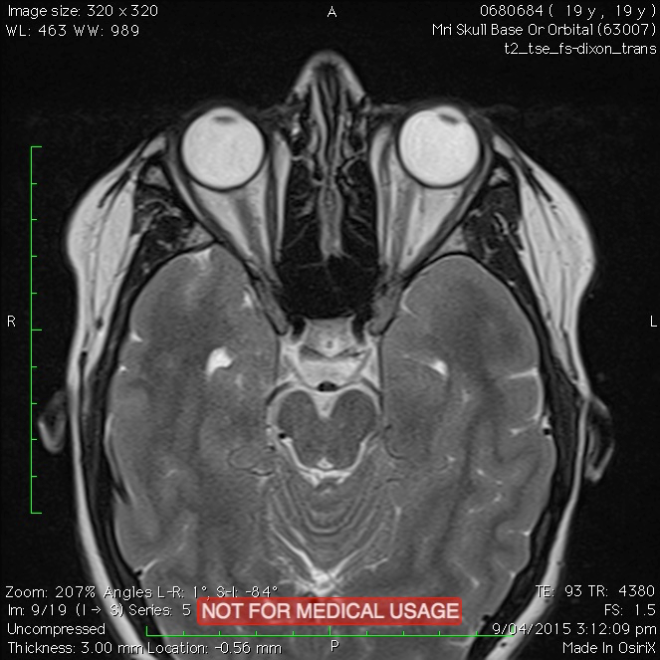
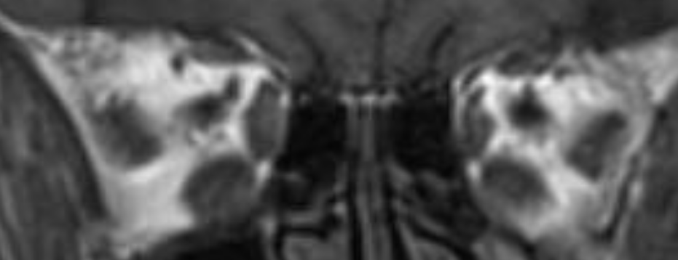
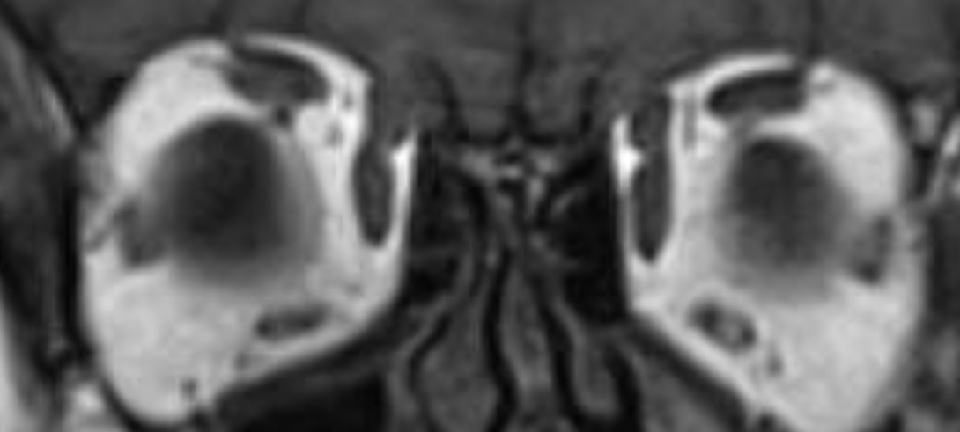
When radiology of the orbits does and doesn’t help in the evaluation of horizontal strabismus
Shivanand Sheth, Raghuvir Kini, Lionel Kowal
The Royal Victorian Eye and Ear Hospital, Melbourne
Purpose
To describe conditions when radiology of the orbits is useful in evaluation of horizontal strabismus, and when it is unlikely to be of help.
Methods
Literature was reviewed, in addition to the authors’ clinical experience, for radiological changes described in imaging of orbits of patients with horizontal strabismus, where radiology co-related with the clinical findings or helped in diagnosis and management. Some illustrative cases are shown below.
Results
Orbital magnetic resonance imaging (MRI) can detect changes in shape, volume and position of extraocular muscles and/or their pulleys in patients with sixth nerve paresis, sixth nerve palsy (Case 3), superior compartment lateral rectus palsy(Case 5), sagging eye syndrome (Case 1), heavy eye syndrome (Case 2), thyroid eye disease [especially unsuspected thyroid eye disease), orbital fracture with entrapment of medial rectus and isolated extraocular muscle palsies (Case 4). No reports for clinical-radiological correlation was found for radiology of the orbits in patients with concomitant horizontal strabismus, Duane’s syndrome or stretched scars following strabismus surgery. 5
1
Sagging Eye Syndrome [SES] may be the commonest cause of small- moderate angle horizontal [+/- vertical] acquired diplopia in the healthy elderly. Coronal MRI shows that the LR’s are lower than the MR’s (red lines), due to dehiscence of the LR-SR band OU (red arrows)
2
3
Coronal MRI scans of the orbit in a patient with bilateral highly myopic strabismus in both eyes.
(Top left) The junction of the optic nerve (ON) and the globe is seen
in this slice. (Bottom right) Circles indicate cross-sections of the muscle cones. The globe is herniated superolaterally between the Superior Rectus and Lateral Rectus muscles – Heavy Eye Syndrome
From Surgical procedure for correcting globe dislocation in highly myopic strabismus. Makoto Yamaguchi, Tsuranu Yokoyama, And Kunihiko Shiraki. Am
J Ophthalmol 2010;149:341–346.
Axial MRI scans of brain and orbits showing bilateral Lateral Rectus atrophy (red arrows), in a patient with traumatic bilateral 6th Cranial Nerve Palsy and large angle esotropia.
4
5
Coronal MRI scans of the orbit in a patients with V-pattern esotropia and left eye abduction deficit, showing significant reduction in volume of the superior compartment of the left Lateral Rectus muscle, and the resulting change in shape compared to the right Lateral Rectus muscle – Superior Compartment Paresis of Lateral Rectus muscle.
MRI of both orbits in a patient with acquired left eye exotropia and loss of adduction, showing isolated Medial Rectus muscle atrophy in the left eye (red arrows)
Conclusion
Radiology of the orbits can help in evaluation, diagnosis and treatment planning in patients with acquired horizontal strabismus associated with abduction and adduction deficits. Radiology of the orbits perhaps does not help in evaluation of concomitant horizontal strabismus, such as infantile esotropia, accommodative esotropia and comitant exotropias, and in Duane’s syndrome or in the evaluation of stretched scars following strabismus surgery.
References
Tan RJD, Demer JL. Heavy eye syndrome versus sagging eye syndrome in high myopia. J AAPOS Off Publ Am Assoc Pediatr Ophthalmol Strabismus. 2015 Dec;19(6):500–6.
Clark RA, Demer JL. Lateral rectus superior compartment palsy. Am J Ophthalmol. 2014;157(2).
Kang N-Y, Demer JL. Comparison of orbital magnetic resonance imaging in duane syndrome and abducens palsy. Am J Ophthalmol. 2006 Nov;142(5):827–34.
Nishida Y, Tian S, Isberg B, Tallstedt L, Lennerstrand G. MRI measurements of orbital tissues in dysthyroid ophthalmopathy. Graefes Arch Clin Exp Ophthalmol. 2001 Nov;239(11):824–31.
Segrest DR, Dortzbach RK. Medial orbital wall fractures: complications and management. Ophthal Plast Reconstr Surg. 1989;5(2):75–80.
Xia S, Li RL, Li YP, Qian XH, Chong V, Qi J. MRI findings in Duane’s ocular retraction syndrome. Clin Radiol. 2014 May;69(5):e191-8.
Oatts JT, Kumar RN, Nyong’o OL. Orbital surface coil imaging predicts surgical anatomy of medial rectus muscle in consecutive exotropia: a case report. J AAPOS Off Publ Am Assoc Pediatr Ophthalmol Strabismus. 2016 Oct;20(5):449–50.
Tychsen L, Richards M, Wong A, Foeller P, Burhkalter A, Narasimhan A, et al. Spectrum of infantile esotropia in primates: Behavior, brains, and orbits. J AAPOS. 2008;12(4):375–80.

